Slide 1
Analytical Methods : Clustering
Feb’10
Sankalp Mathur (sankalp.mathur@gmail.com)

Slide 2
Topics
Clustering
Joining/Hierarchical Tree
Two Way Joining
k-Means Clustering
SAS Clustering Procedures
Pre-Processing Steps

Slide 3
Clustering
It encompasses of multiple grouping algorithms for unsupervised learning which aim at maximizing the degree of association between two object in the same group and minimizing it otherwise
Statistical significance is not the point of emphasis here given the fact that analysis is in exploratory phase. Different algorithms aim at finding the most optimal solution possible
There are multiple methods of clustering like Joining (Tree Clustering), Two-Way Joining (Block Clustering), k-Means Clustering and more
SAS supports a number of clustering algorithms with varying complexity which will be studied shortly

Slide 4
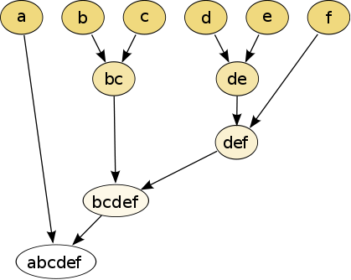
Joining / Hierarchical Tree
The purpose of this algorithm is to join together objects into successively larger groups based on certain measure of similarity or distance
Distance Measures
Euclidean Distance
Squared Euclidean Distance
Manhattan Distance
Chebychev’s Distance
Power Distance
Percentage Disagreement
Amalgamation or Linkage Rules
Single Linkage (Nearest Neighbor)
Complete Linkage (Farthest Neighbor)
Un-weighted Pair Group Average
Weighted Pair Group Average
Un-weighted Pair Group Centroid
Weighted Pair Group Centroid (Median)
Wards’s Method
A Dendogram

Slide 5
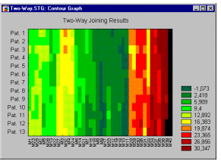
Two Way Joining
Two way joining is the clustering method which aims at combining attributes (or variables) and observations simultaneously to unveil meaningful clusters of data
The results are sometimes slightly difficult to interpret due to the fact that similarities between clusters may pertain to or be caused by somewhat different subset of variables

Slide 6
k-Means Clustering
Creates k clusters with greatest possible distinction based on
Minimization of within cluster variance and
Maximization of between cluster variance
Works similar to ANOVA with the distinction that the observations may move in and out of clusters to maximize significance of the results
In practice the clustering is performed in the following steps
#1 Define k observations as cluster centers in the first pass through data
#2 Assign a new observation to one of the clusters based on a measure
#3 Recalculate Cluster center’s
#4 Repeat the previous two steps if convergence criteria is not met

Slide 7
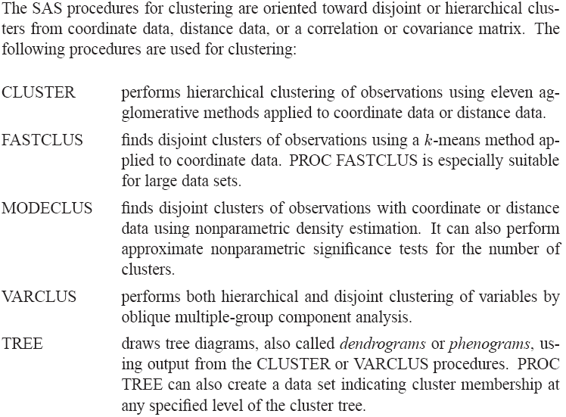
SAS Clustering Procedures

Slide 8
SAS Pre-Processing Steps
ACECLUS: Attempts to estimate the pooled within-cluster covariance matrix from coordinate data without knowledge of the number or the membership of the clusters. PROC ACECLUS outputs a data set containing canonical variable scores to be used in the cluster analysis proper.
PRINCOMP : Performs a principal component analysis and outputs principal component scores.
STDIZE: Standardizes variables using any of a variety of location and scale measures, including mean and standard deviation, minimum and range, median and absolute deviation from the median, various m estimators and a estimators, and some scale estimators designed specifically for cluster analysis.

Slide 9
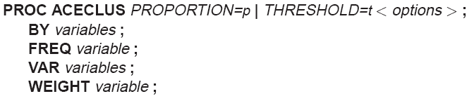
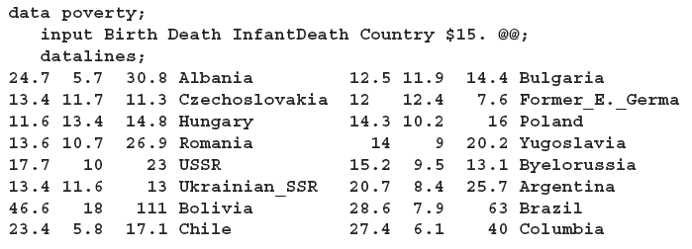
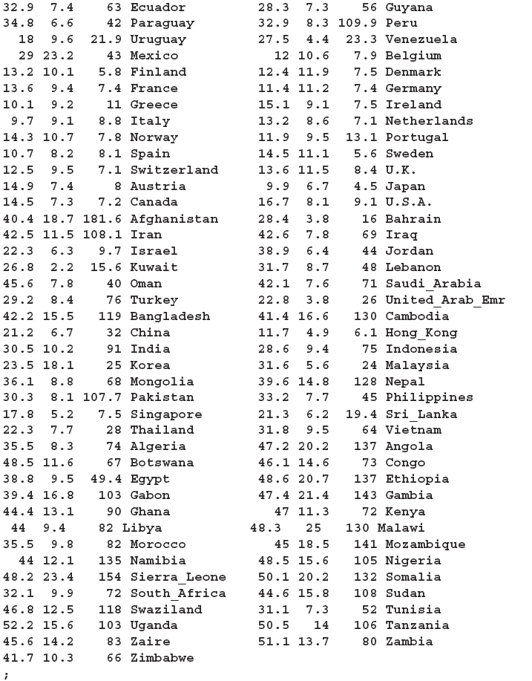
PROC ACECLUS
Pre-processing step to create canonical scores which could be used in further clusters. Most clustering techniques well with spherical clusters but not with elliptical or elongated clusters. ACECLUS leverages the ingenious method devised by Art, Gnanadesikan and Kettenring for estimation of within cluster covariance matrix without prior knowledge of the clusters
Data from Rouncefield containing birth rate, death rate and infant death rate of 97 countries

Slide 10
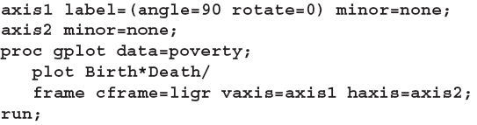
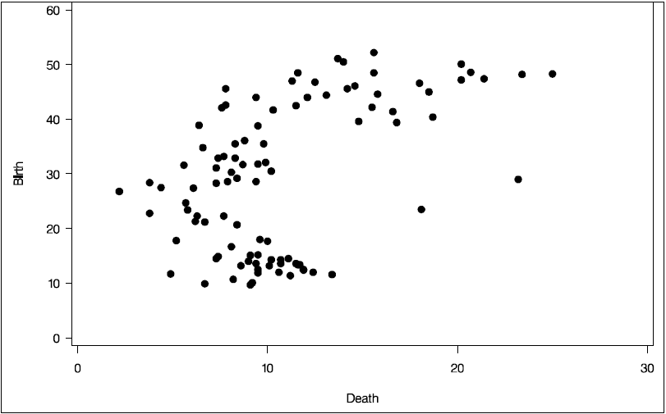

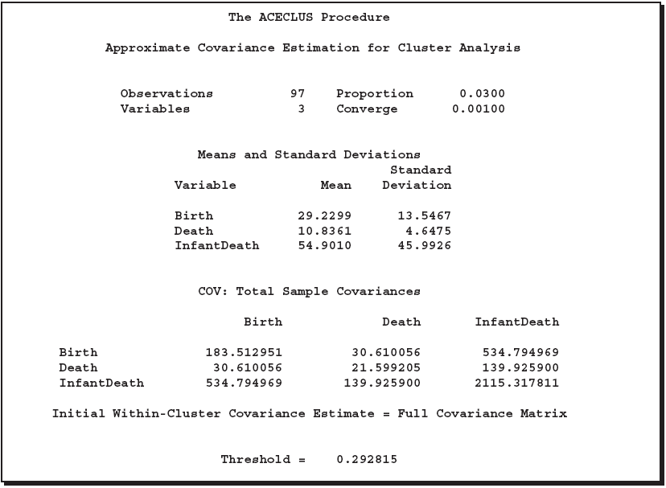
PROC ACECLUS
Elongated data hence aceclus must be used for cluster methods to work
Mean and Standard deviation of the clustering variables
Threshold level to calculate close pairs
Total sample covariance matrix

Slide 11
PROC ACECLUS
Root Mean Square distance between clusters
Pairs within the cutoff distance

Slide 12
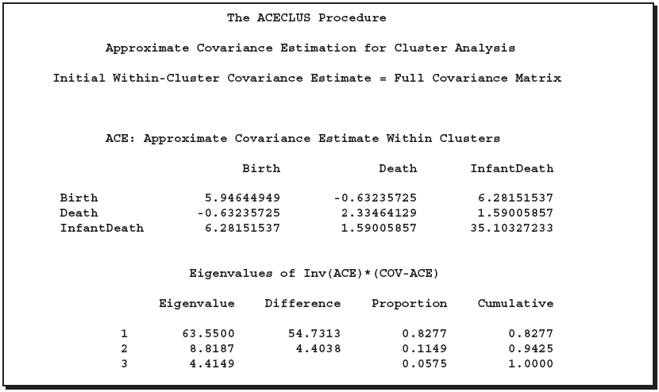
PROC ACECLUS
Approximate covariance matrix estimate within clusters

Slide 13
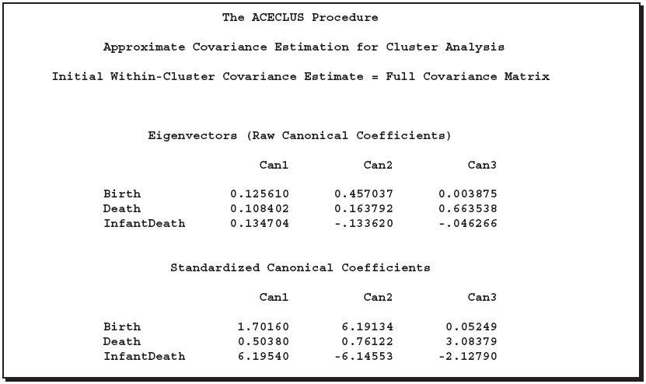
PROC ACECLUS
Canonical variables are created to be used in clustering
Standardized by dividing by std dev

Slide 14
PROC FASTCLUS
Performs a disjoint cluster analysis on the basis of distance computed from specified quantitative variables
Each observation belongs to a unique cluster and does not form a tree like structure
Initialization method is sensitive to outliers
For complete convergence CONVERGE=0 and a large MAXITER value must be specified else default settings often stop the method
Initial Seed selection is based on MAXCLUSTERS and RADIUS option
It is advisable to observe the variances in the data and standardize it since variables with larger variances have greater influence in calculation of clusters
This step is generally used prior to using CLUSTER procedure for hierarchical clusters or other clustering techniques due to its speed

Slide 15
PROC FASTCLUS (Illustration)
New Observation
n
1
2
Previous Cluster Seeds
Previous Cluster Seeds
1
4
3
n is a seed if r_{in} > R for all i if i<MAXCLUSTERS
In case i>MAXCLUSTERS Seed could be replaced If (min(r_{1n},r_{2n},r_{3n},r_{4n})=r_{2n}) > (min(r_{12,}r₁₃,r₁₄,r₂₃,r₂₄,r₃₄)=r₁₂) then n can replace 2 else if (min(r_{1n},r_{3n},r_{4n}) =r_{4n})>(min(r₂₁,r₂₃,r₂₄)=r₂₁) then n replaces 2 else n is added to the closest cluster

Slide 16
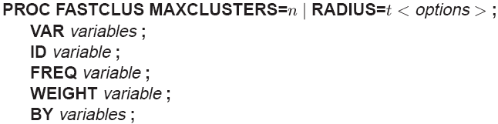
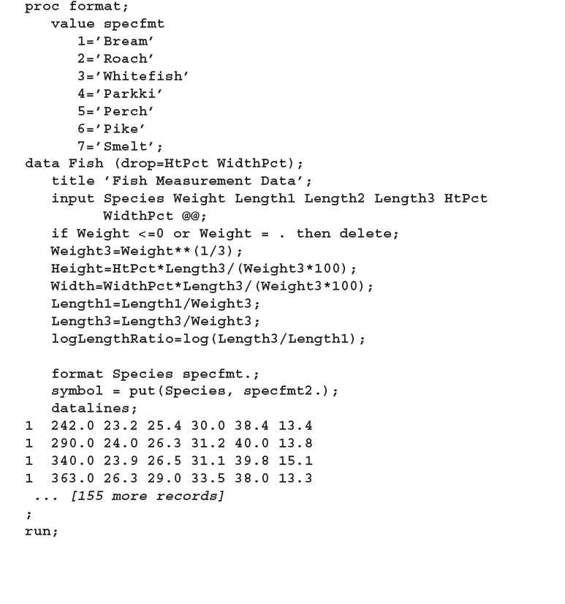
PROC FASTCLUS
Procedure is directly inspired by Hartigan’s leader algorithm and Macqueen’s k-means algorithm. FASTCLUS uses a method by Andberg called nearest centroid sorting.
The data in this example are measurements taken on 159 fish caught off the coast of Finland. The species weight, three different length measurements height, and width of each fish are tallied. The height and width are recorded as percentages of the third length variable.

Slide 17
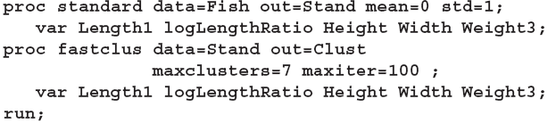
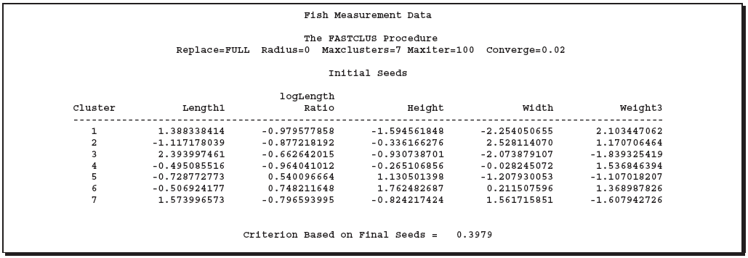
PROC FASTCLUS
Initial Seeds

Slide 18
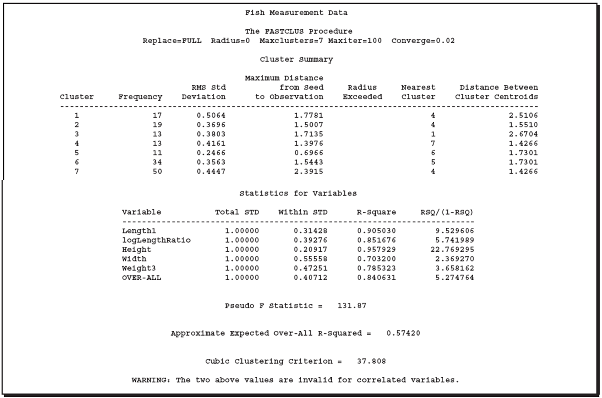

PROC FASTCLUS
Distance between cluster 1 and 4 centroids
Root Mean Square distance between obs in a cluster
Pooled within cluster standard deviation
Ability to predict this variable from within the cluster
R²/(c-1) / (1-R²)/(n-c) where R² is observed overall R², c is # of clusters and n is the # of obs
Value of 2-3 indicate good cluster, 0-2 potential clusters and large negative values indicate outliers

Slide 19
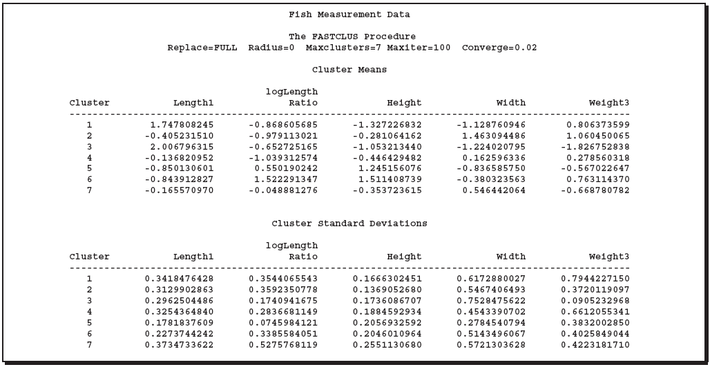
PROC FASTCLUS
Means of individual variable calculated within each cluster obs
Standard deviation of individual variable calculated within each cluster obs

Slide 20

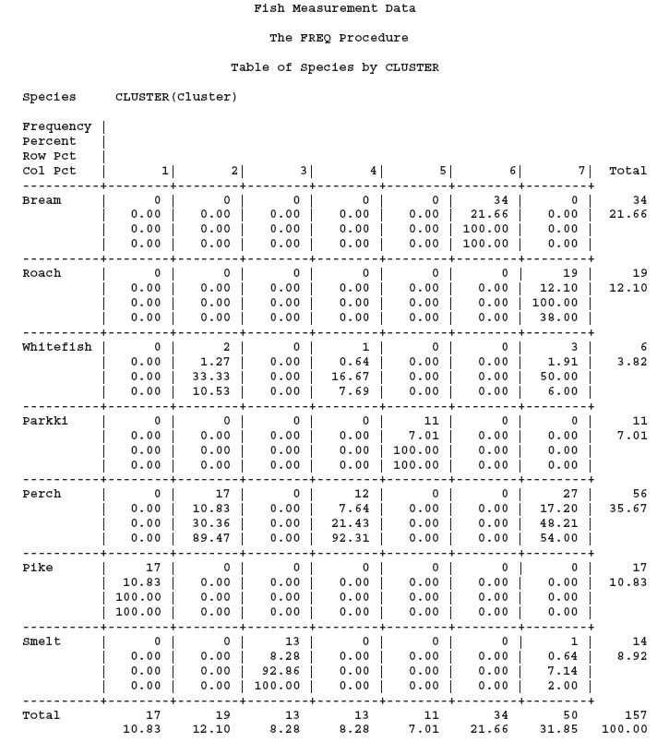
PROC FASTCLUS (Post Steps)
Observe the results of clustering
FASTCLUS identifies certain species into other clusters
Might be useful to run canonical discrimination analysis to observe the clusters from canonical variables
?
?
?

Slide 21
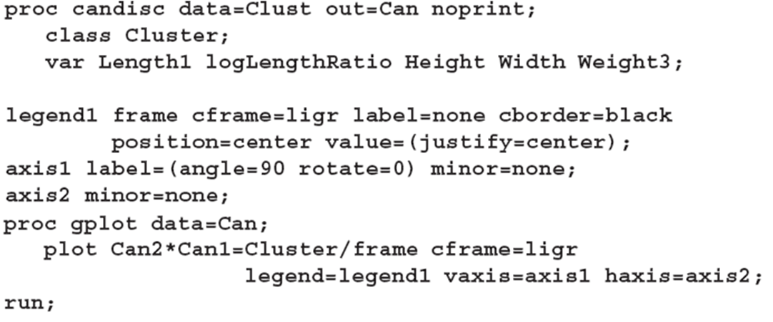
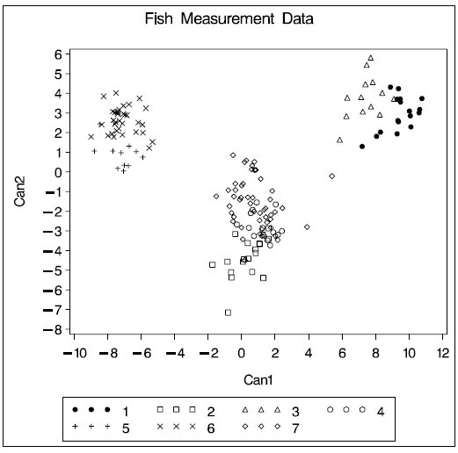
PROC FASTCLUS (Post Steps)
Observe the results of clustering from the canonical variables perspective

Slide 22
PROC CLUSTER
Performs hierarchical clustering using various methods within the agglomerative algorithm framework
Uses Euclidean distances for numerical data and Non-Euclidean distances for Categorical data
Not practical for very large data sets since the CPU time varies as square or cubic power to the number of observations
Displays a history of clustering process for estimating the number of clusters in the population from which the data is sampled
Creates an output data set that can be used by the TREE procedure to draw a tree diagram of the cluster hierarchy up to any desired level
It is advisable to observe the variances in the data and standardize it since variables with larger variances have greater influence in calculation of clusters. ACECLUS, PRINCOMP, STD procedures are helpful

Slide 23
PROC CLUSTER (Methods)
Supported Methods are
Average Linkage
Centroid Method
Complete Linkage
Density Linkage
kth Nearest neighbour
Uniform Kernel
Wong’s Hybrid
EML
Flexible Beta
McQuitty’s Similarity
Median
Single Linkage
Two Stage Density Linkage
Ward’s Minimum Variance

Slide 24

PROC CLUSTER (Illustration)

Slide 25
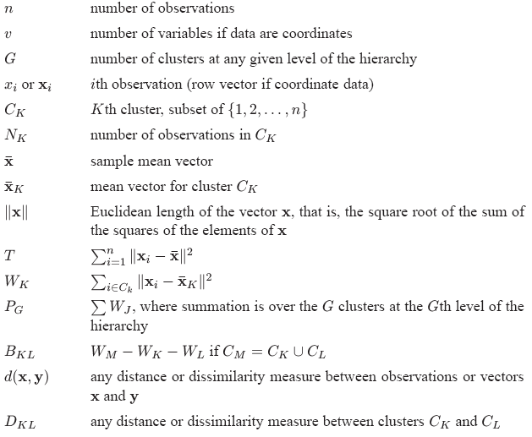
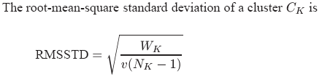




PROC CLUSTER (Important Stats)

Slide 26
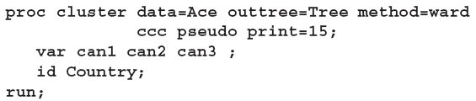

PROC CLUSTER (Illustration)
Note that Ward’s Method was used
Using the data produced by the ACECLUS procedure example for birth, death and infant death by countries
PROC CLUSTER first displays the table of eigenvalues of the covariance matrix for
the three canonical variables

Slide 27
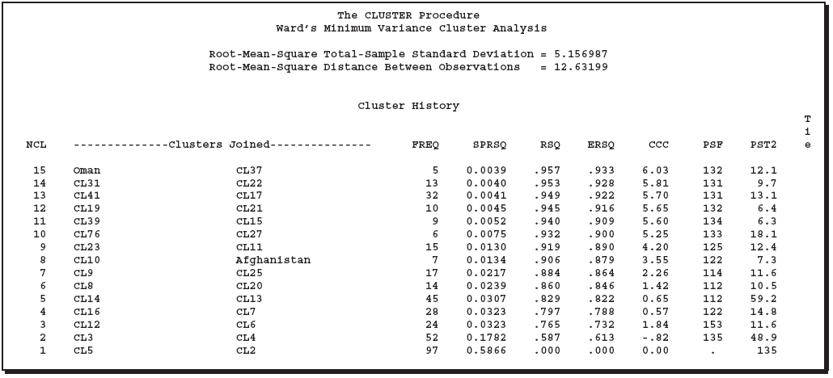
PROC CLUSTER (Illustration)
Pseudo F Criteria
Semi-Partial R² : Accounts for decrease in proportion of variance due to cluster joining
R² Expected
R² Proportion of variance accounted by the clusters
Cubic Clustering Criteria
Pseudo t² Criteria
CCC shows local maxima on optimal clusters

Slide 28
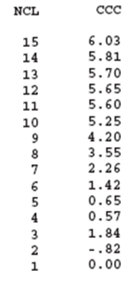
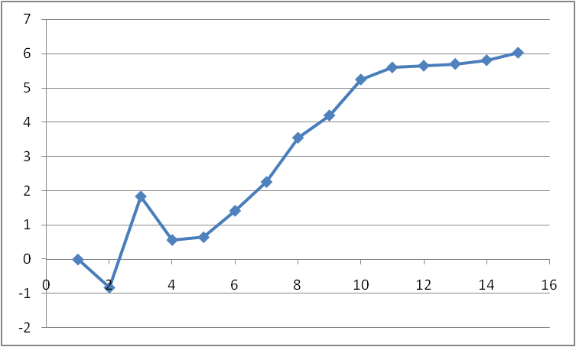
PROC CLUSTER (Illustration)
3 Clusters
10 Clusters
CCC shows local maxima on optimal clusters
Clustering must be tried with multiple METHODS to gain confidence on how many clusters are optimal and significantly different

Slide 29
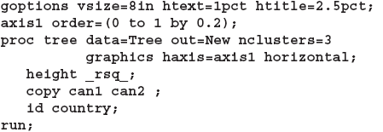
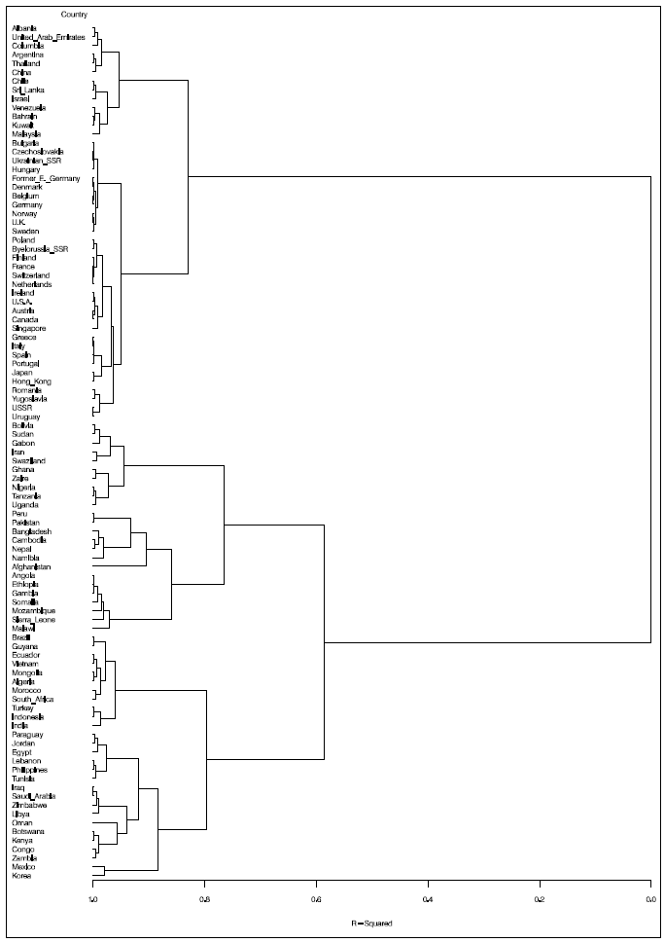
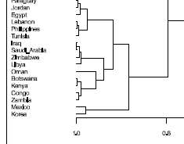
PROC TREE
Primarily used for cluster visualization in case of hierarchical clustering using the output from CLUSTER/VARCLUS procedures
Shows a dendogram or phenogram and can also create a dataset showing cluster membership at any specified level of association

Slide 30
PROC MODECLUS
Clusters using algorithm based on Non parametric density estimates
For NPDE algorithm, cluster is a region surrounding a local maximum of a probability density function
MODECLUS can find clusters of unequal size and dispersion with highly irregular shapes
Number of clusters is not defined but is given by MODECLUS output however a smoothing parameter and significance level is provided
Data must be co-ordinate or distance based and scaling/transformation must be considered
Different methods proceed and create clusters is very different ways from Method=0 to Method=6 hence self study is essential (Illustration is not provided)

Slide 31
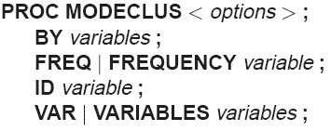
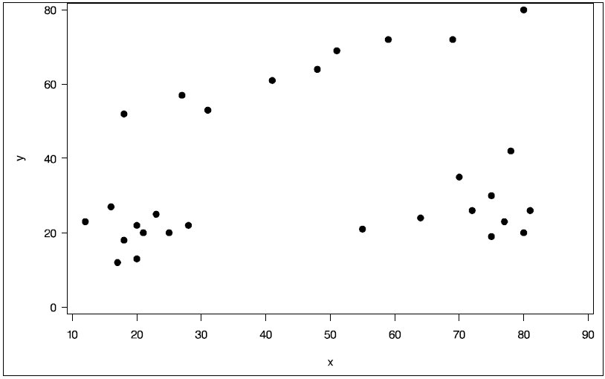
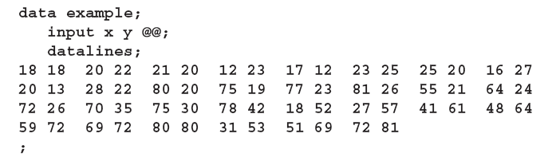
PROC MODECLUS
Performs NPDE. Only first statement is mandatory with one of the DK=, K=, DR=, or R= smoothing parameters and METHOD option
This is an artificial dataset which contains groups of data which have different and not necessarily spherical shape to illustrate the technique of MODECLUS.

Slide 32
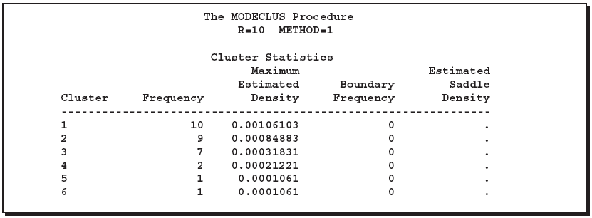
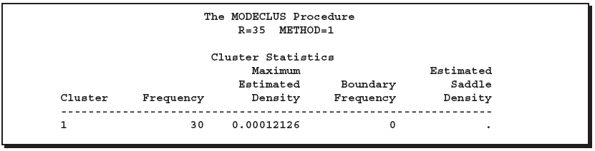
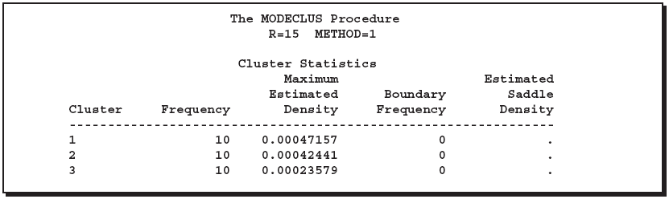

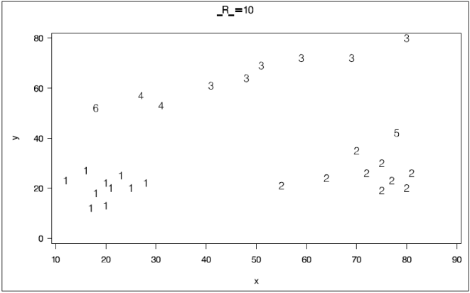

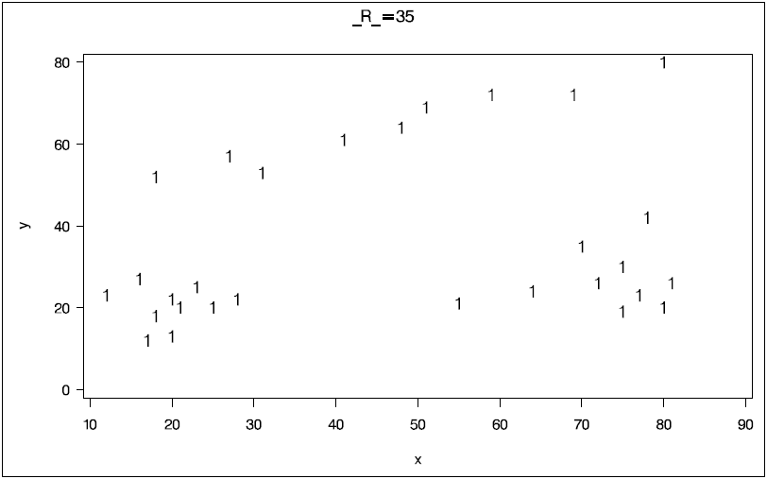
PROC MODECLUS
Procedure uses (hyper)spherical uniform kernels of fixed or variable radius. Density estimate at a point is computed by dividing the number of observations within a sphere centered at the point by the product of the sample size and the volume of the sphere. The size of the sphere is determined by the smoothing parameters that you are required to specify.
Clusters are well separated hence 0
Based on Boundary freq similar to density estimate

Slide 33
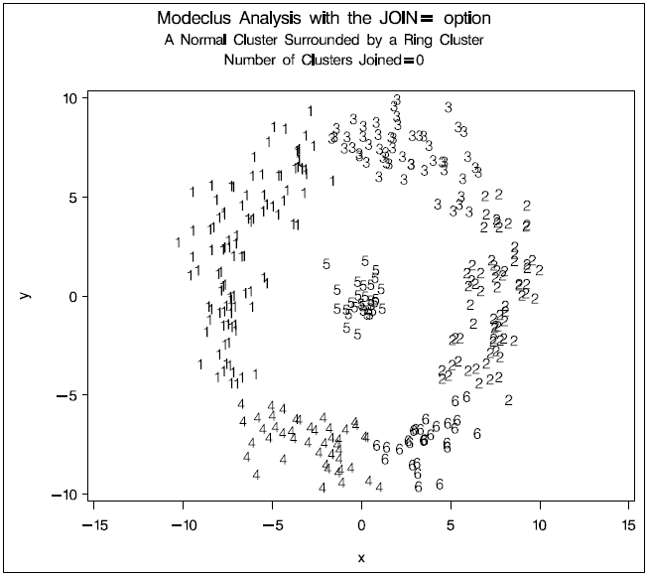
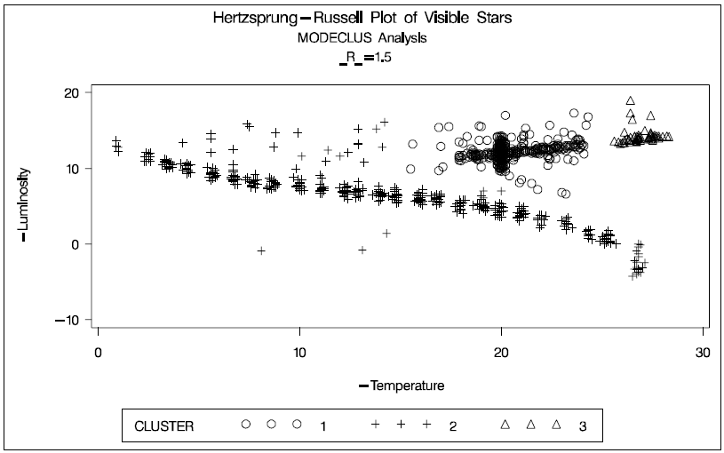
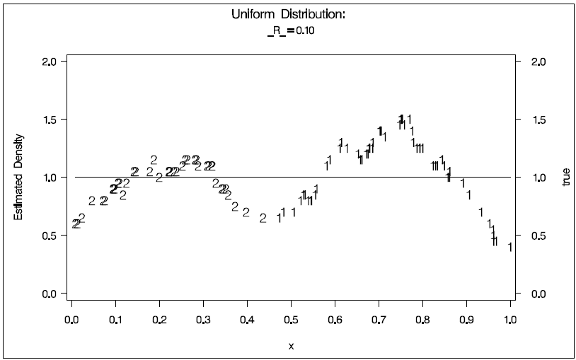
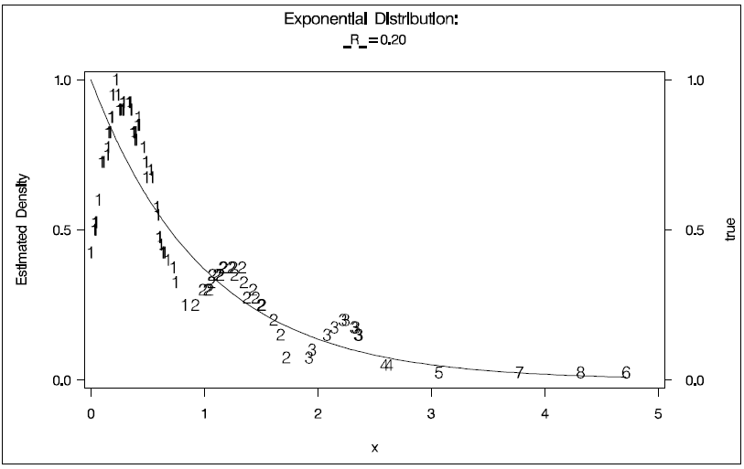
PROC MODECLUS (Various Clusters)

Slide 34
PROC VARCLUS
Divides a set of numeric variables into hierarchical or disjoint clusters
Each cluster is a linear combination of the variables in the cluster which may be either the first principal component or the centroid component
Attempts to maximize the sum across clusters of the variance of the original variables that is explained by the cluster components
It is used as a variable reduction method
A large dataset can be replaced by the set of cluster components with little loss of information
Principal components usually explain larger variance compared to clusters however cluster variables are easier to explain with little loss of information

Slide 35
PROC VARCLUS (Illustration)
Var 1
Calculate Principal Components
PC 1
Var 2
Var 3
PC 2
PC 3
Perform Ortho Oblique transformation based on first two principal components
Var 4
PC 4
Var 5
Var 6
PC 5
PC 6
PC 1
Use the default or user defined criteria to re-iterate based on cluster with lowest variance or second principal component cluster
Variable which has max correlation with PC1
PC 2
PC 3
Var 1
PC 4
Var 3
PC 5
PC 6
Var 2
Variable which has max correlation with PC2
Var 4
Divide into two clusters by assigning to each rotated component the variable with which its correlation is maximized
Var 5
Var 6
Perform variable reassignment between clusters to maximize variance

Slide 36
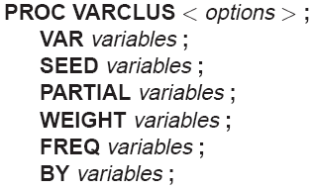
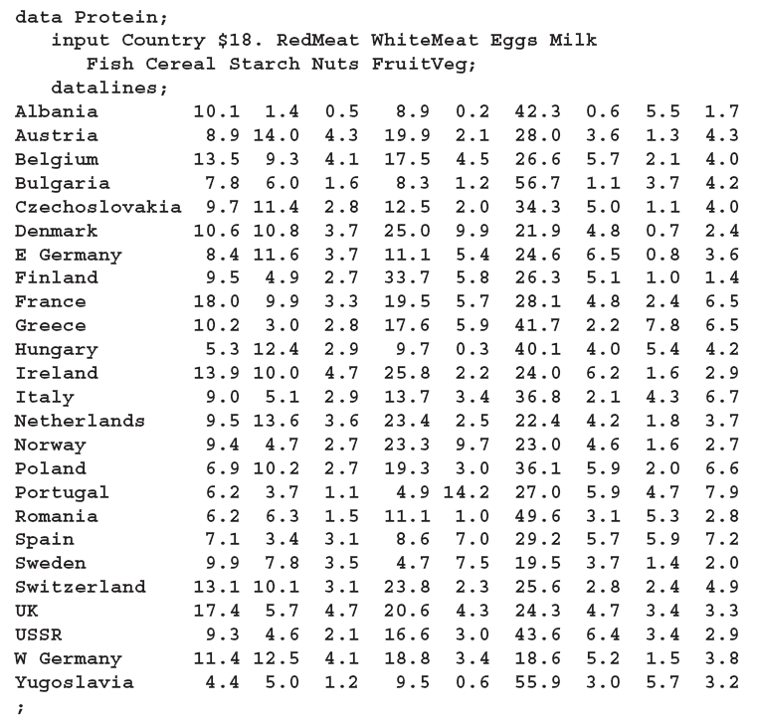
PROC VARCLUS
Performs variable clustering. Only VAR statement is mandatory except PROC VARCLUS
The following data, from Hand, et al. (1994), represent amounts of protein consumed
from nine food groups for each of 25 European countries. The nine food groups are red meat (RedMeat), white meat (WhiteMeat), eggs (Eggs), milk (Milk), fish (Fish), cereal (Cereal), starch (Starch), nuts (Nuts), and fruits and vegetables (FruitVeg).

Slide 37
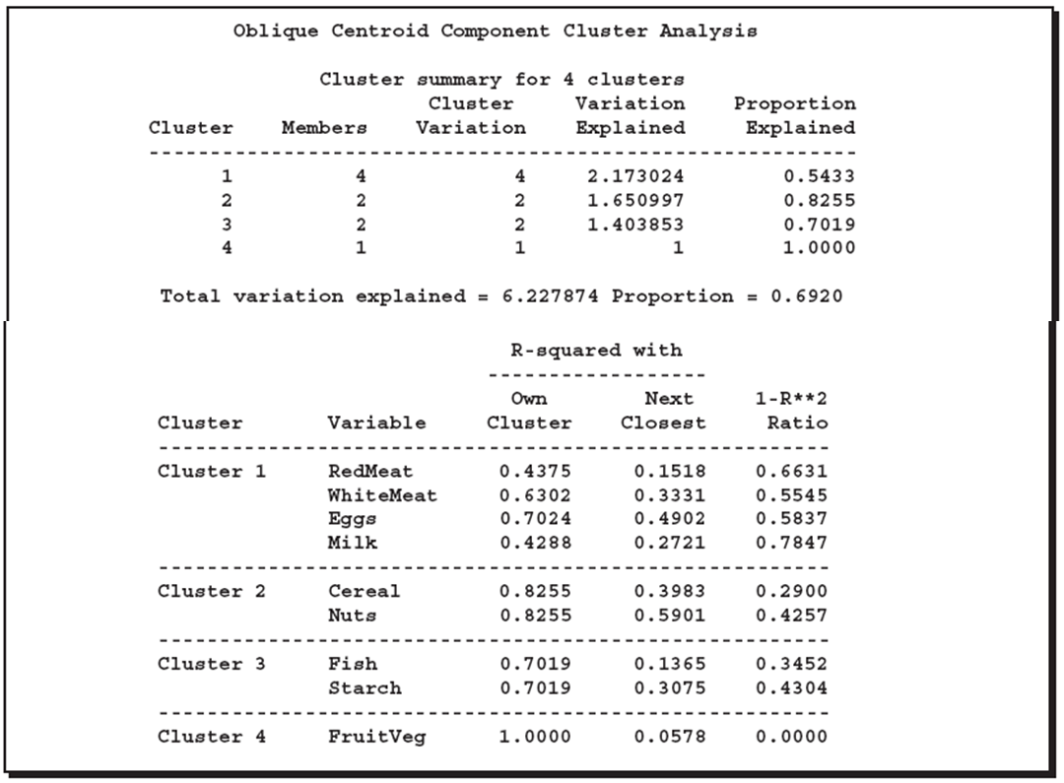
PROC VARCLUS
Variation explained by the component associated with the cluster
Proportion of variance explained i.e. variation explained by the component cluster divided by number of variables
R² observed with the component associated with own cluster, indicates the contribution to this cluster
R² observed with the component associated with nearest cluster, indicates how well the clusters are separated
The Lower the better

Slide 38
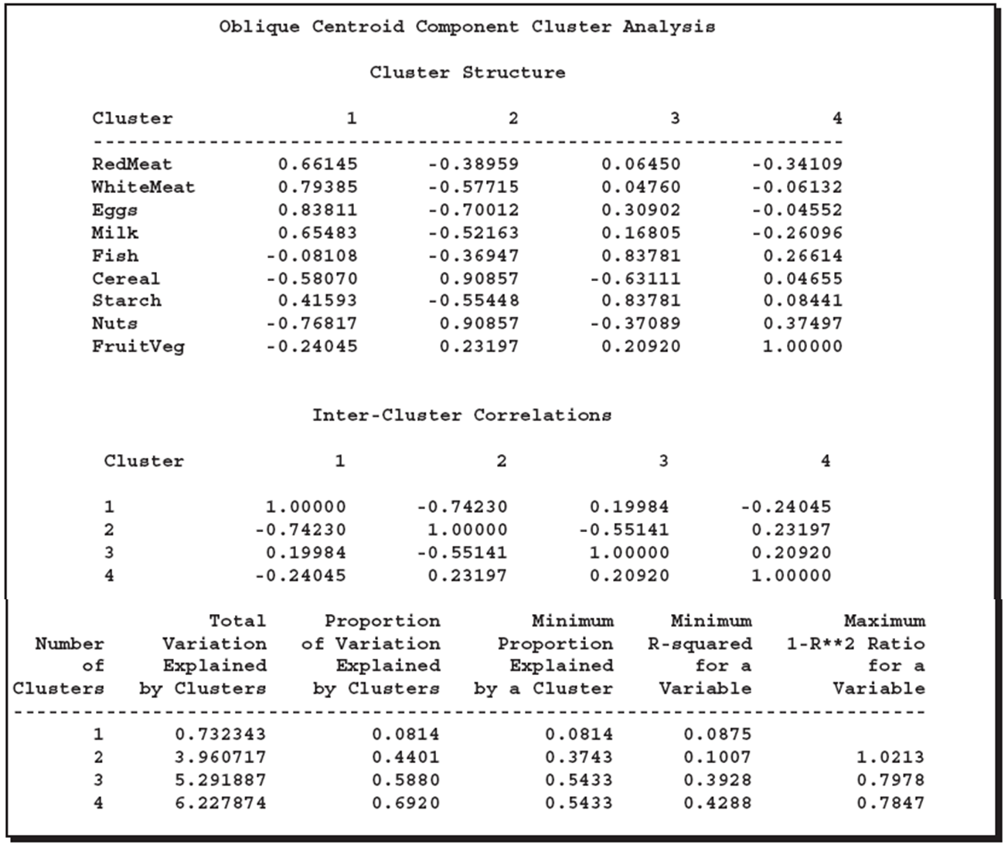
PROC VARCLUS
Correlation between each variable and the cluster components
Correlation between each of the cluster components

Slide 39
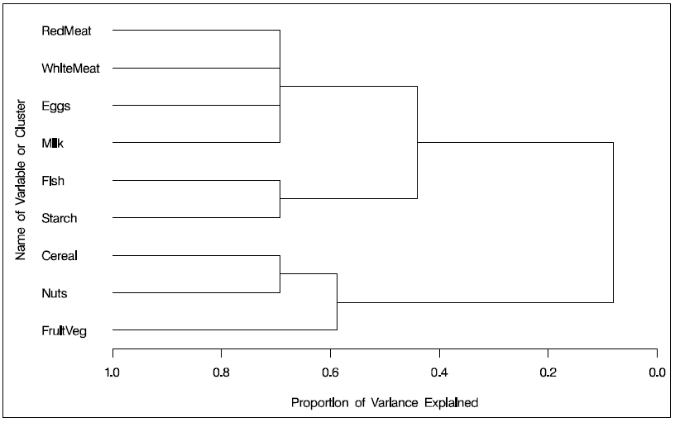
PROC VARCLUS

